Slide 2
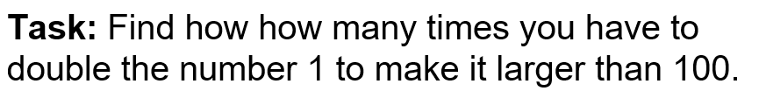

Slide 3
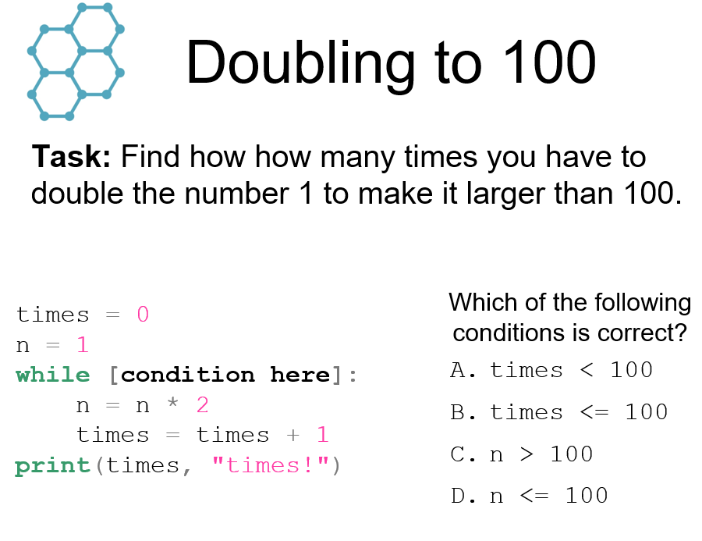

Slide 5
Count down code:

Slide 6
Count down code:

Slide 7
Count down code:

Slide 8
Count down code:

Slide 9
Count down code:

Slide 10
Count down code:

Slide 11
Count down code:

Slide 12
Count down code:

Slide 13
Count down code:

Slide 14
Count down code:

Slide 15
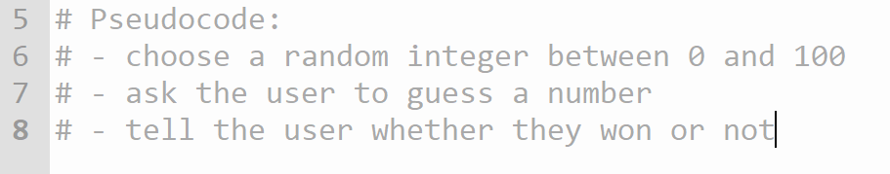

Slide 16
Random guess code

Slide 17
Random guess code

Slide 18
Random guess code

Slide 19
Random guess code

Slide 20
Random guess code

Slide 21
Random guess code

Slide 22
Random guess code

Slide 23
Random guess code

Slide 24
Random guess code

